Slide 1



Technical Facilities of Infrimation
Prepared & Presented by: Mirlan Nurbekov, Lecturer
Office hours: Friday 9:00–17:00
AlaToo IT & Business College
Fall 2025

Slide 2
Course Introduction
This course explores the key technologies behind information processing, storage, and communication. Students will learn to configure, secure, and manage modern information systems through practical labs and lectures. It builds a solid foundation for careers in computer engineering, software development, and information systems management.

Slide 3
Grading & Assessment
Midterm test: a comprehensive assessment of materials from week 1 till week 8 (100 points)
Final exam (100 points)

Slide 4

Introduction to the Digital World

Slide 5

Introduction to the Digital World

Slide 6

Introduction to the Digital World

Slide 7
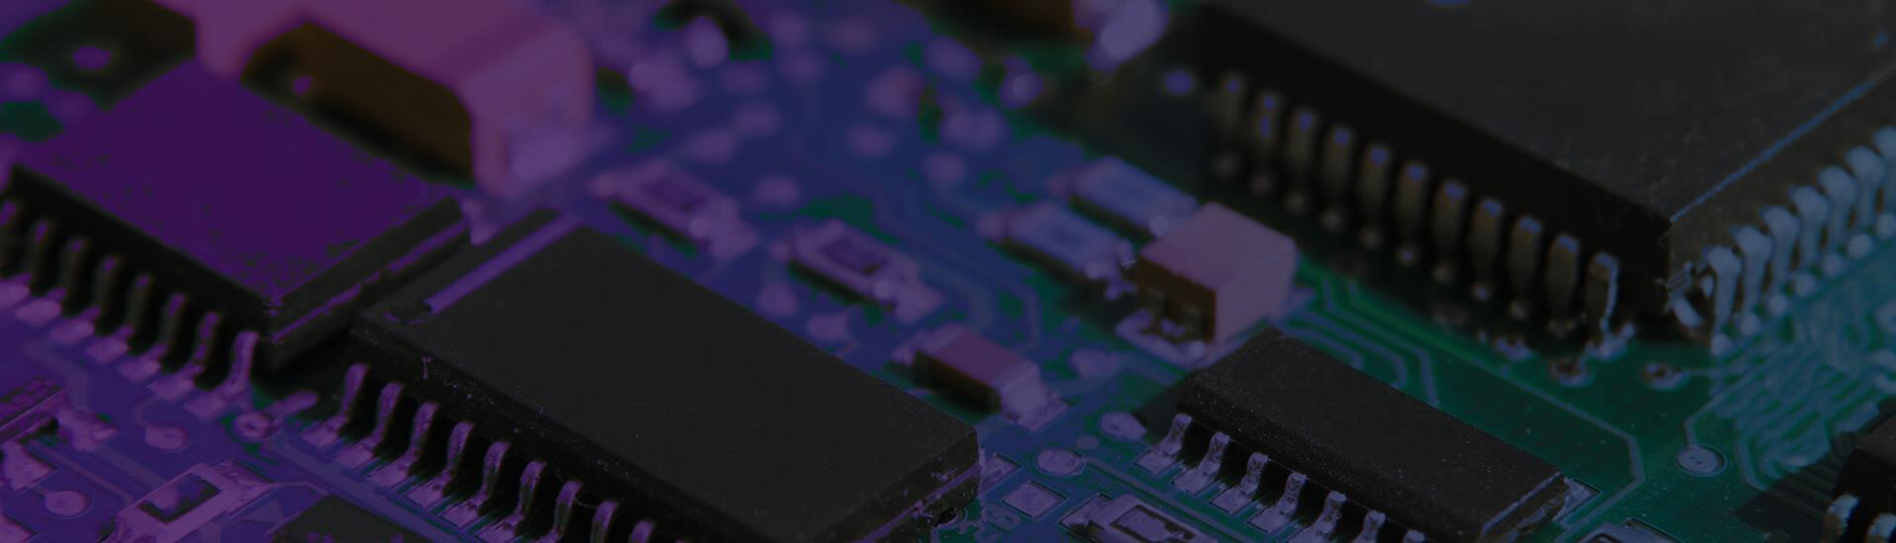
The Physical World

Slide 8
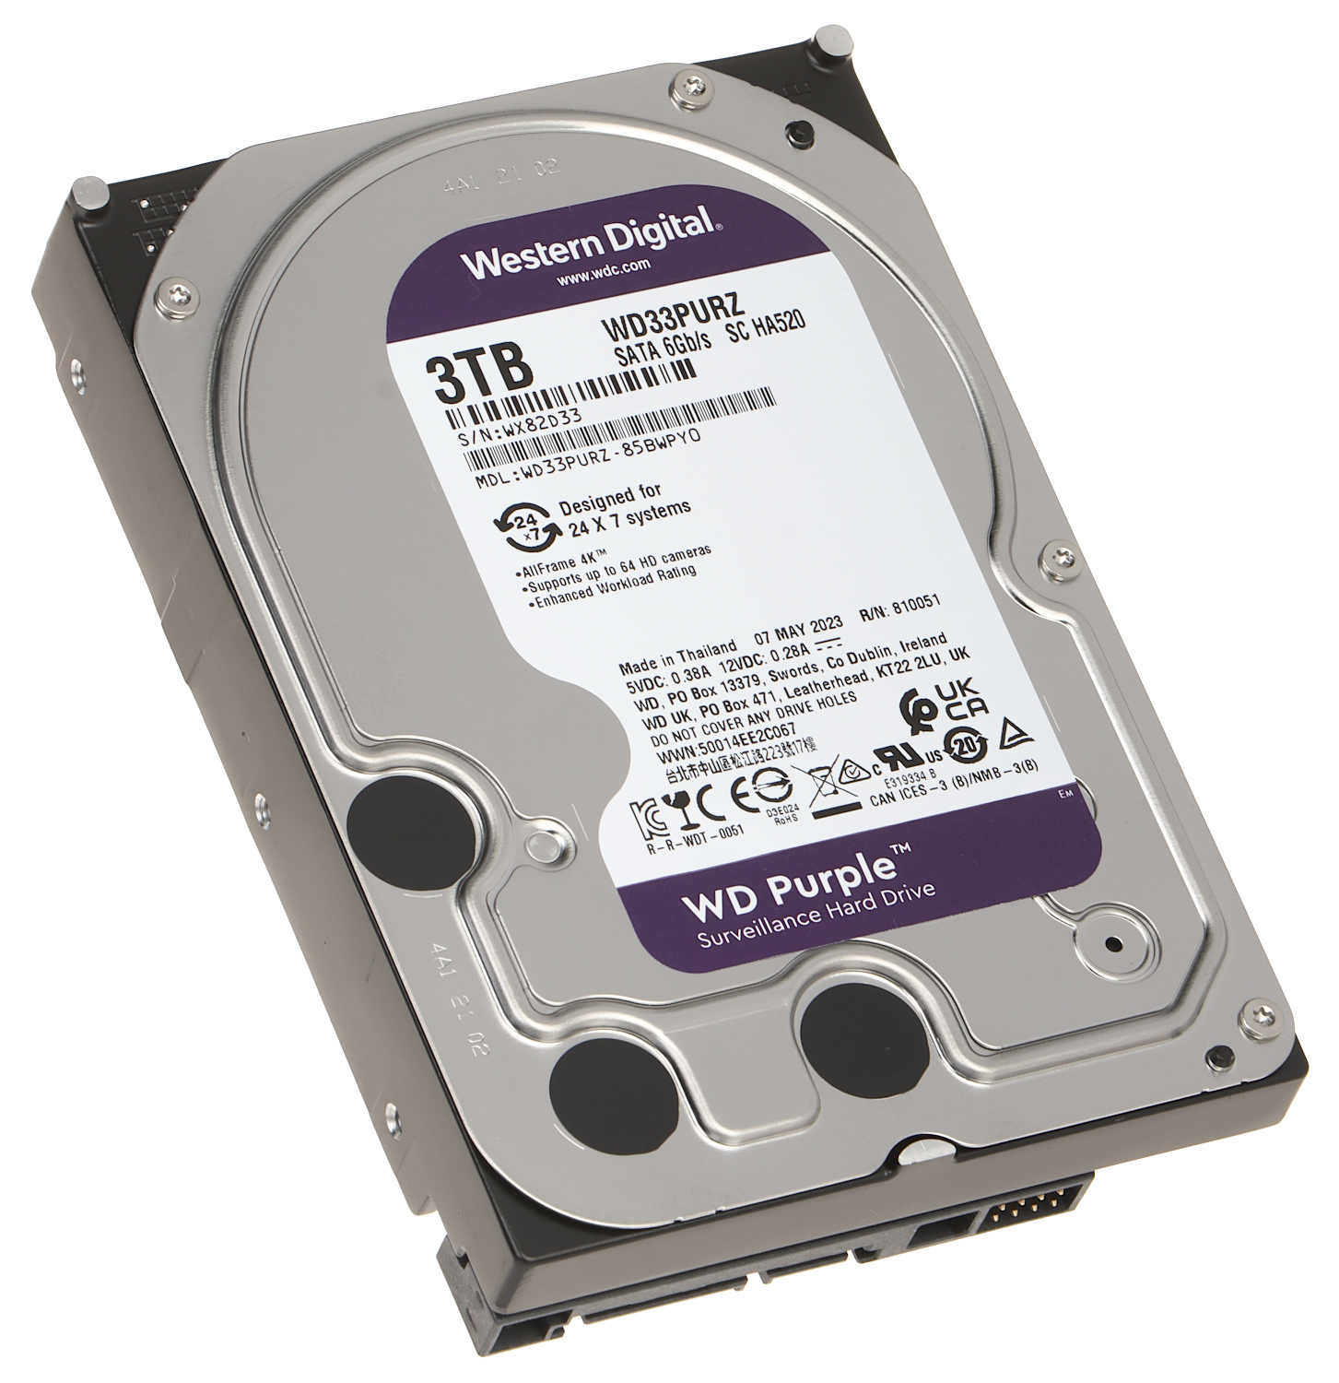
Hard Disk Drive (HDD)

Slide 9
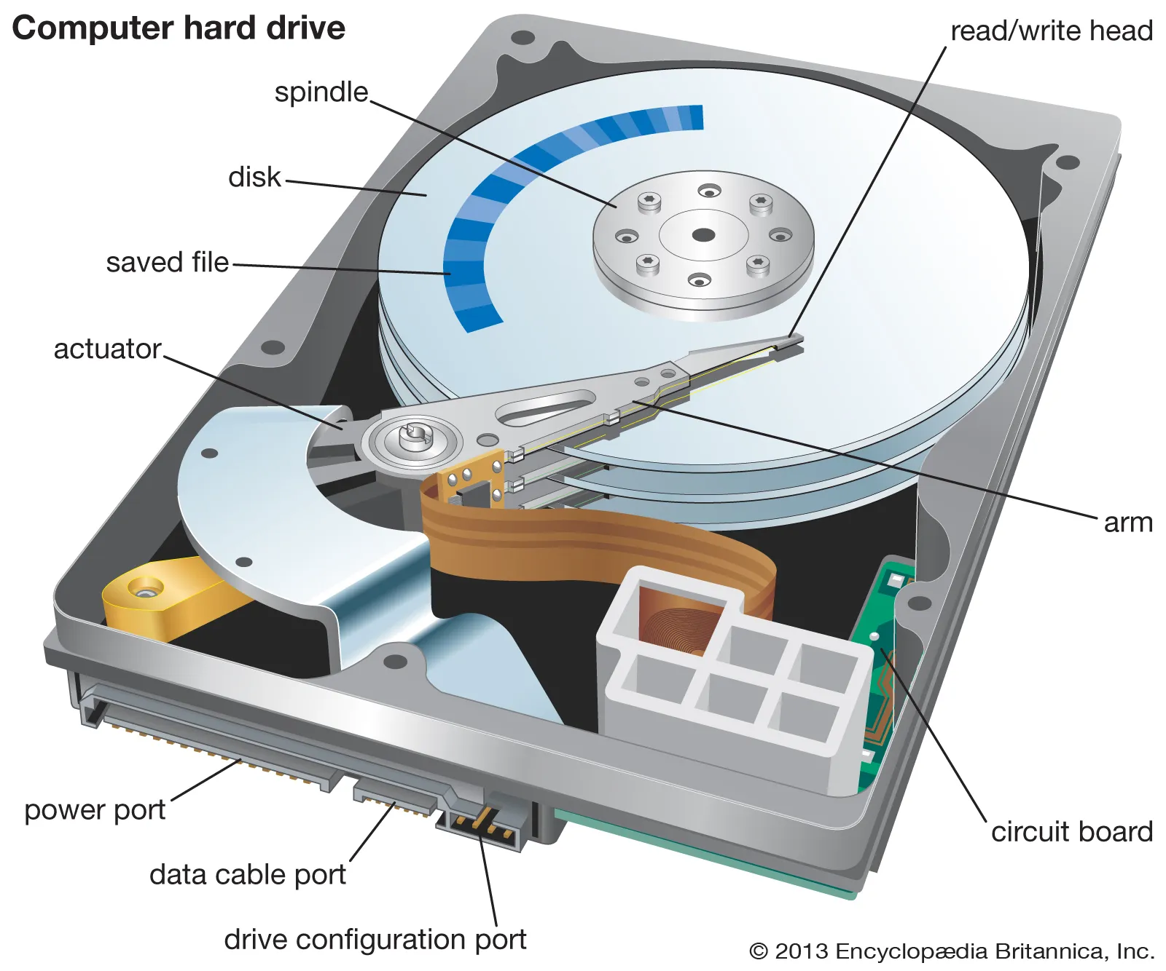
Main parts of HDD
Platters – circular disks that store data using magnetism
Spindle – rotates the platters at high speed (e.g., 5400 or 7200 RPM)
Read/Write Head – tiny arm that moves across platters to read/write data
Actuator Arm – positions the read/write head with precision
Controller – the "brain" that manages all operations

Slide 10
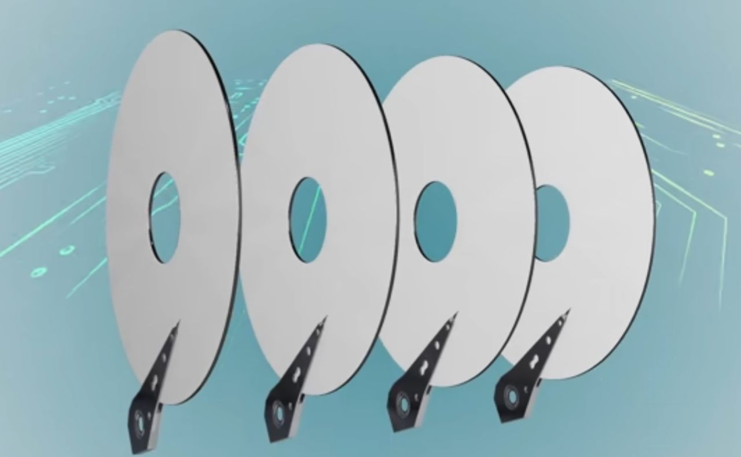

Slide 11
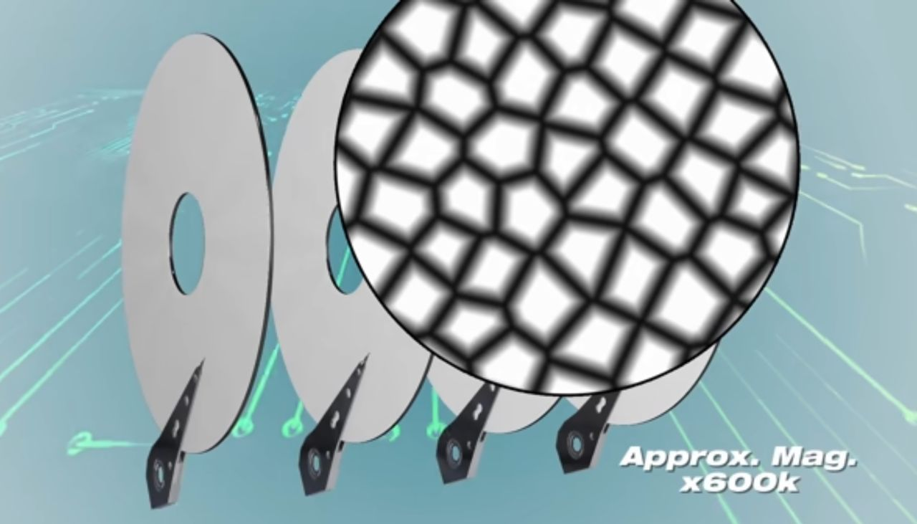

Slide 12
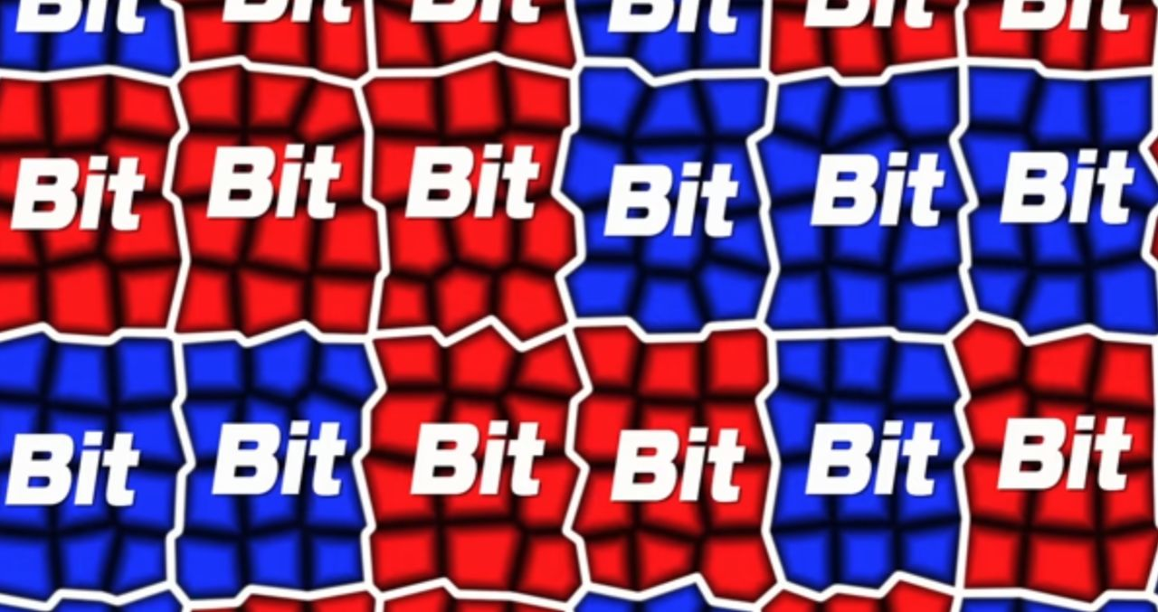

Slide 13
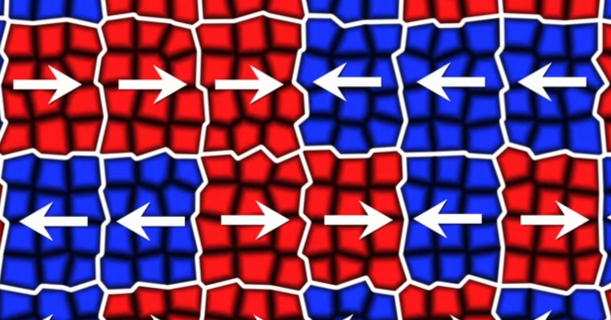

Slide 14


Slide 15
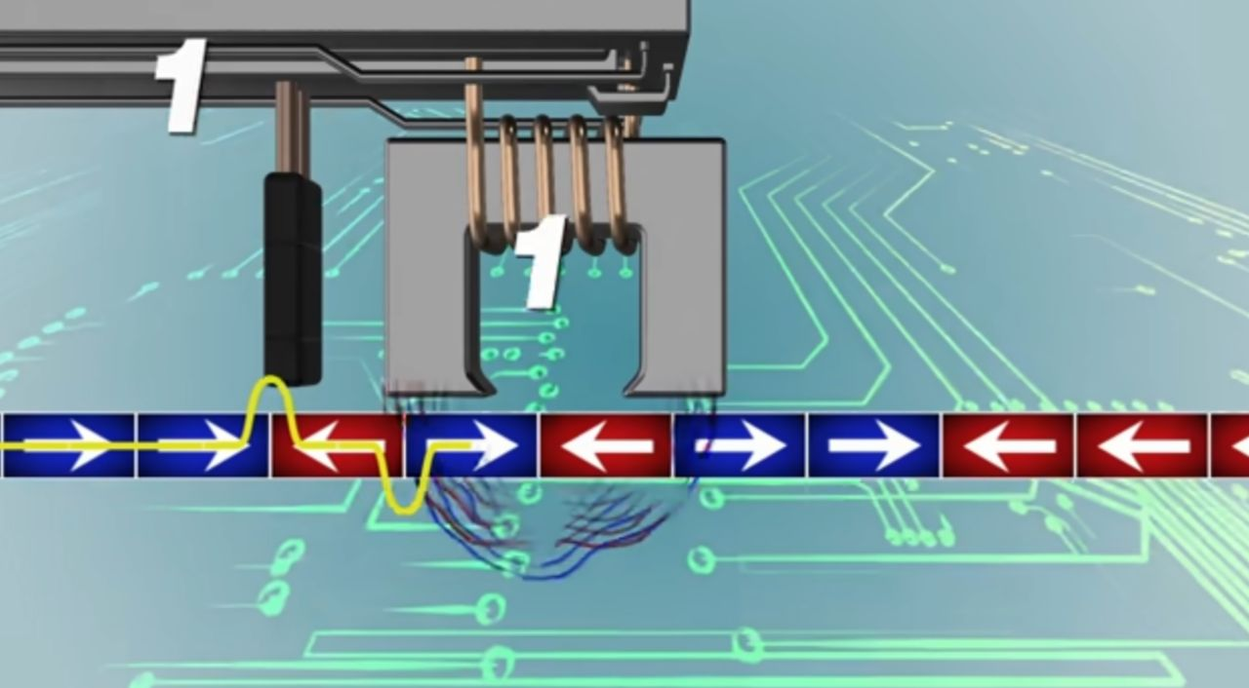

Slide 16
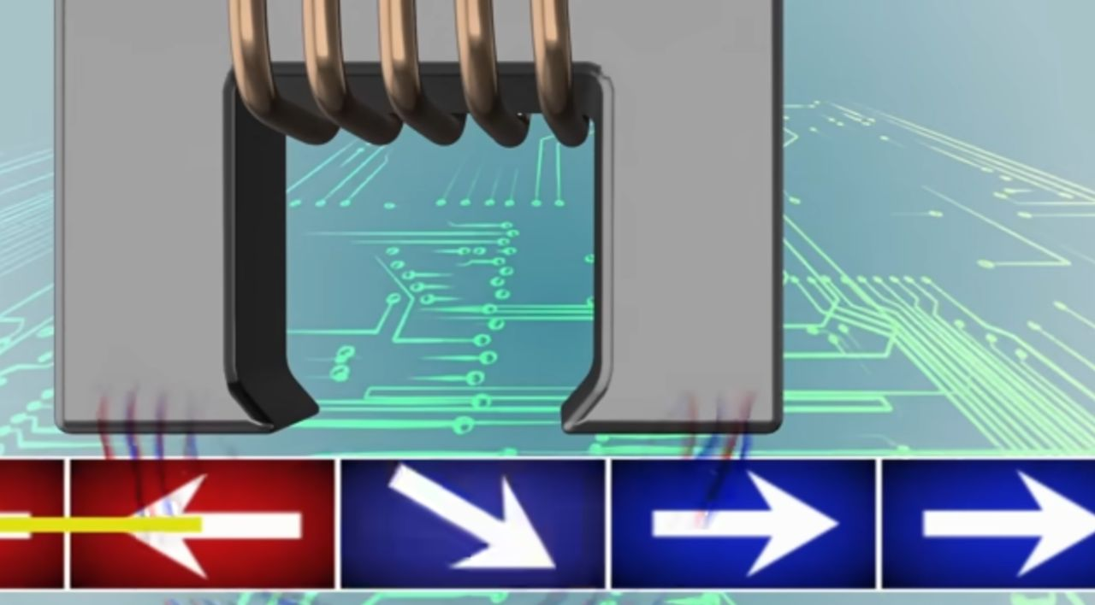

Slide 17
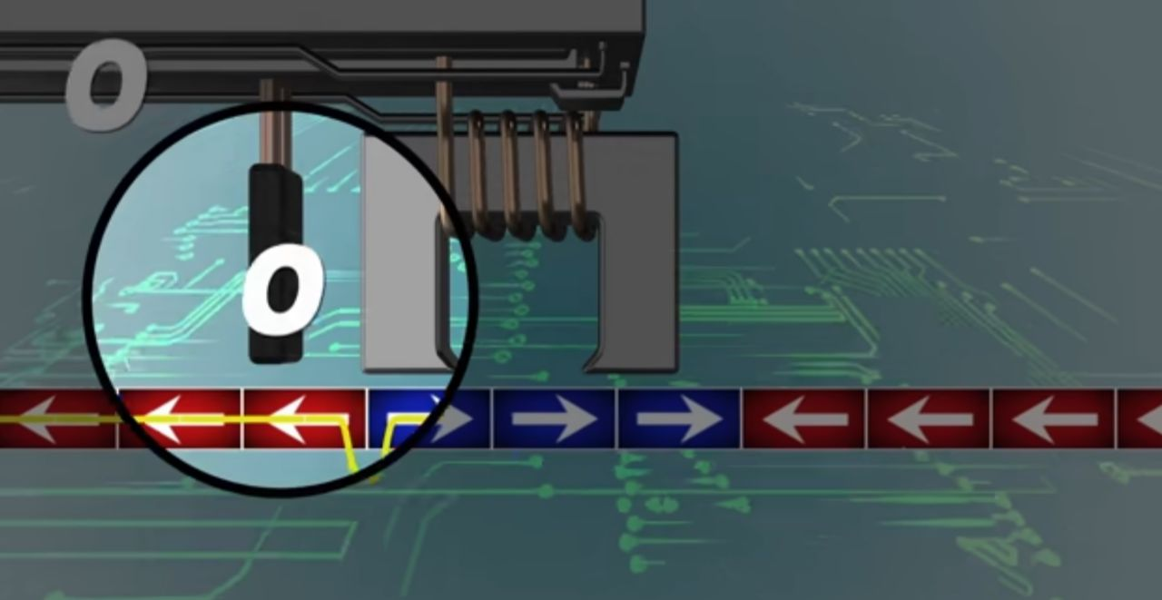

Slide 18
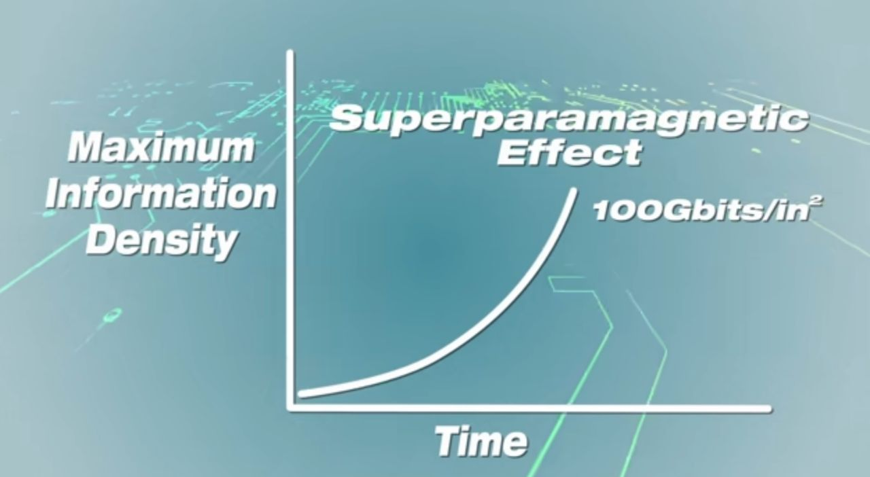

Slide 19
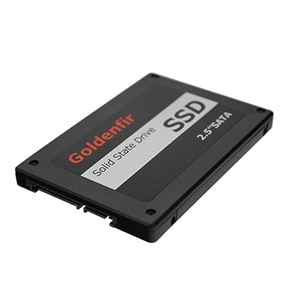
Solid State Drive (SSD)

Slide 20
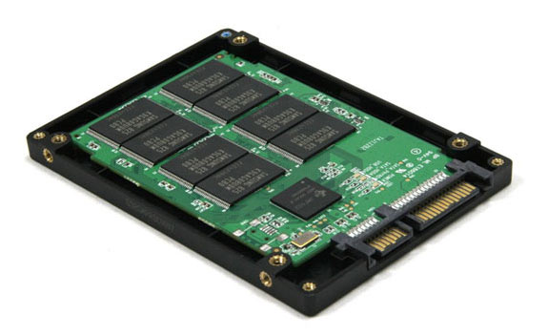
Solid State Drive (SSD)
NAND chips - filing cabinets where information is stored
Controller - office manager who knows where every file is
DRAM cache - desk where the manager puts files for quick use
Interface - office door connecting to the outside world

Slide 21
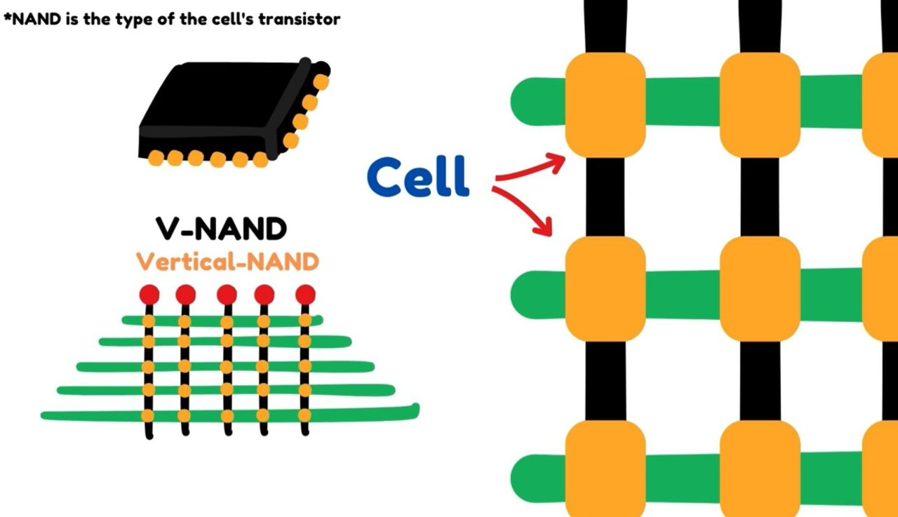

Slide 22
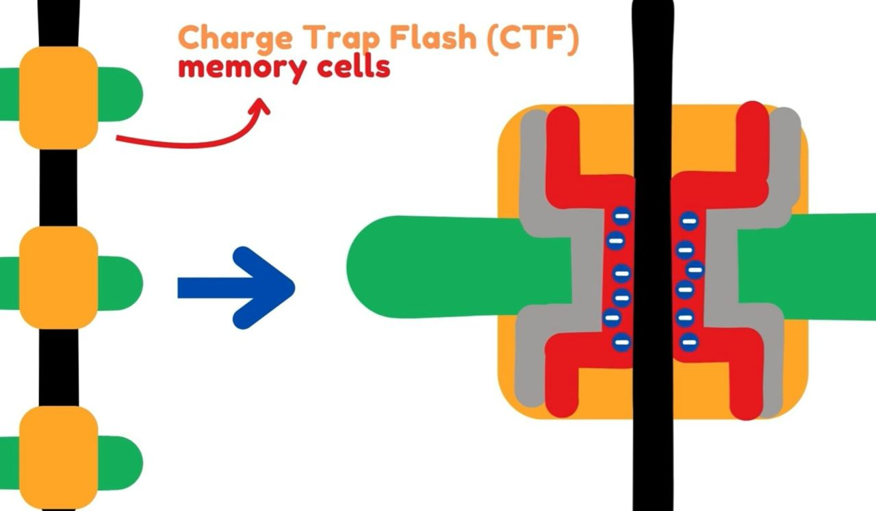

Slide 23
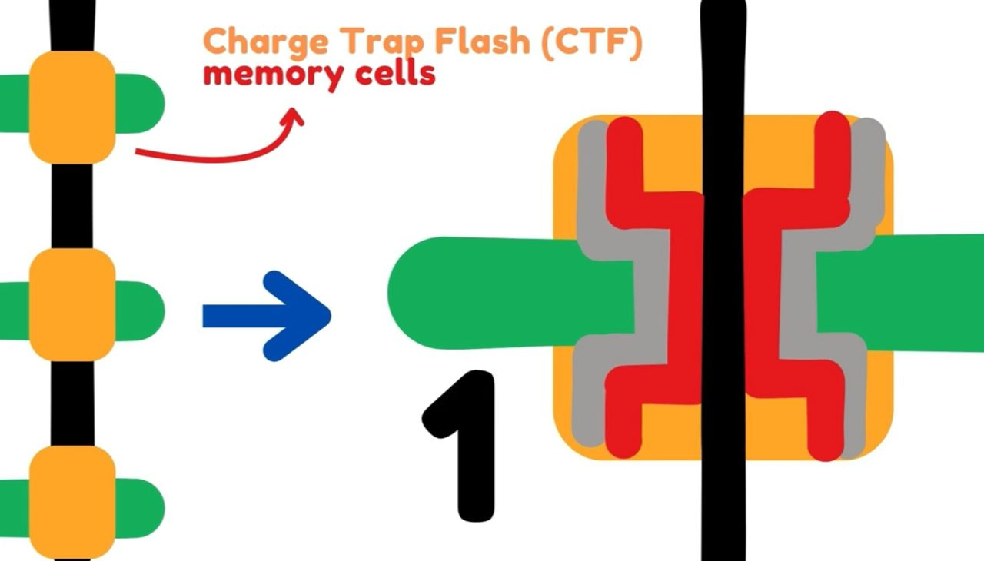

Slide 24
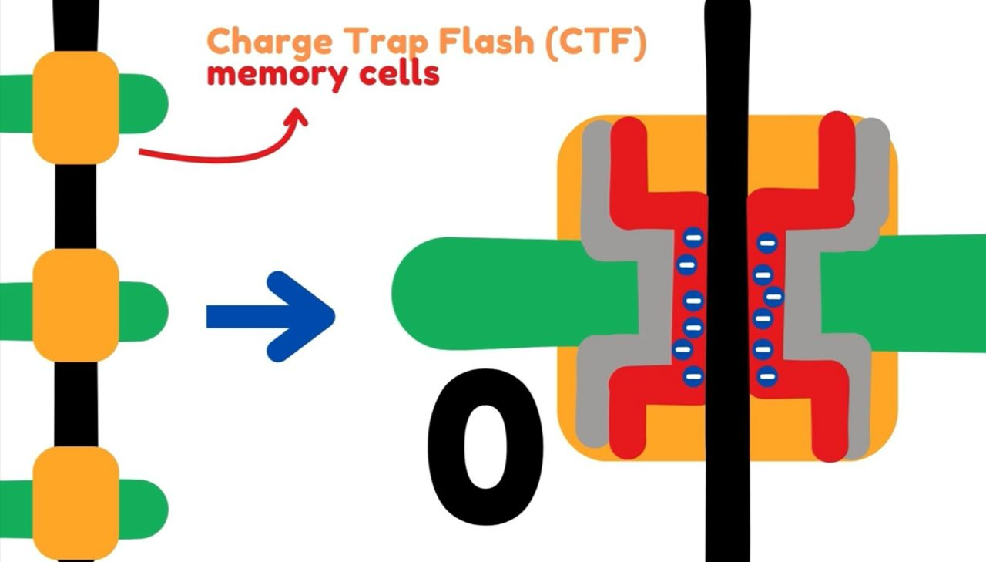

Slide 25
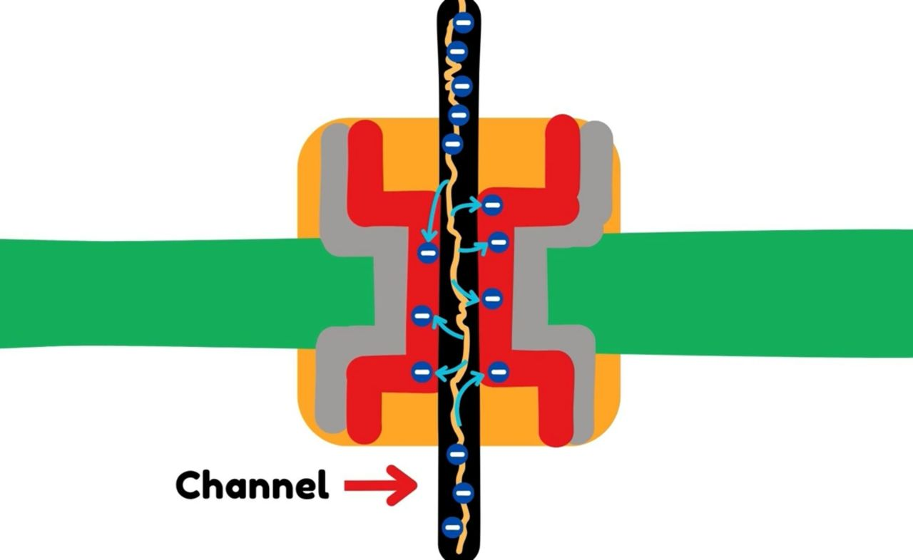

Slide 26
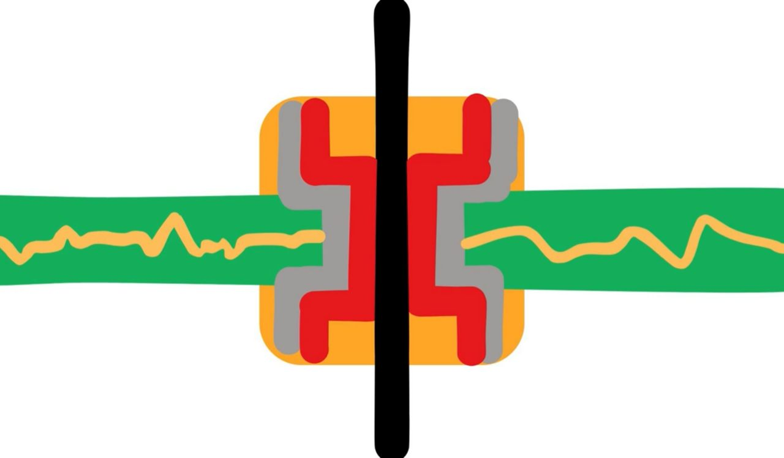

Slide 27
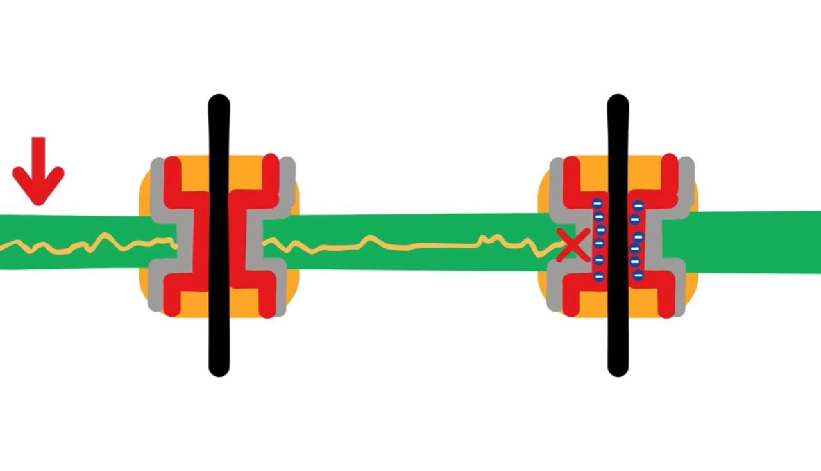

Slide 28
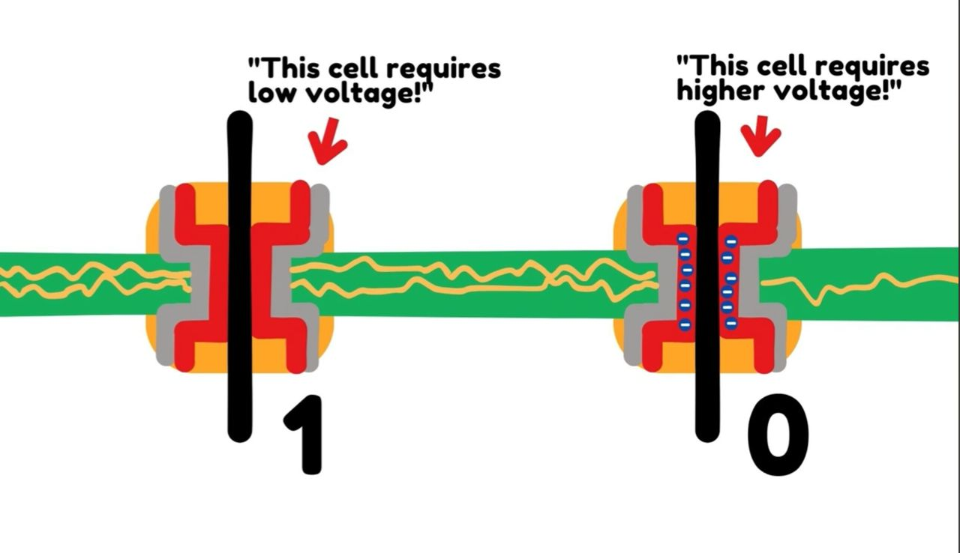

Slide 29
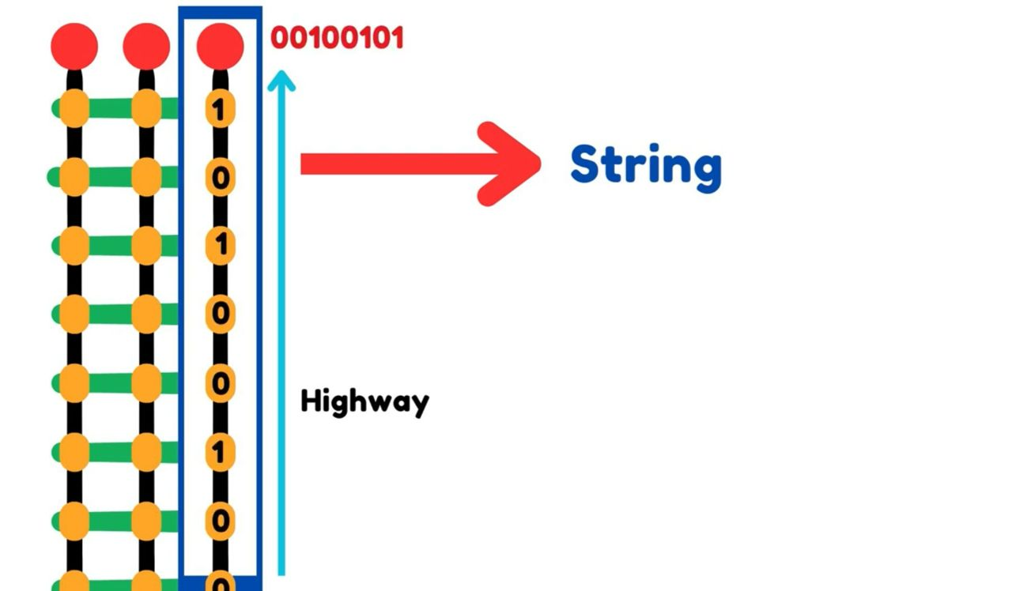

Slide 30
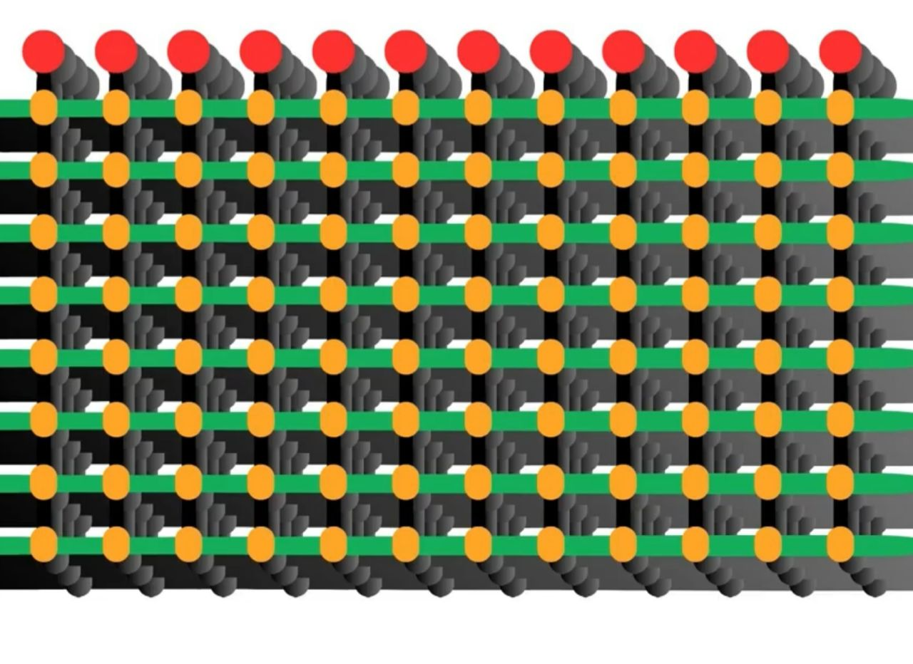

Slide 31
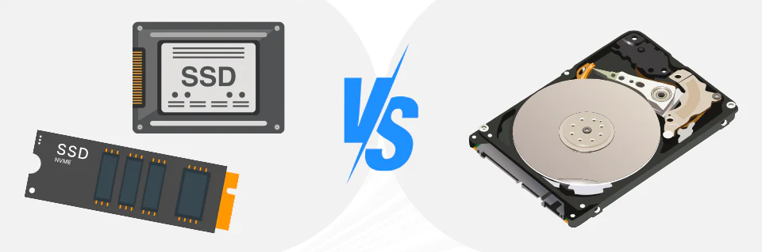

Slide 32
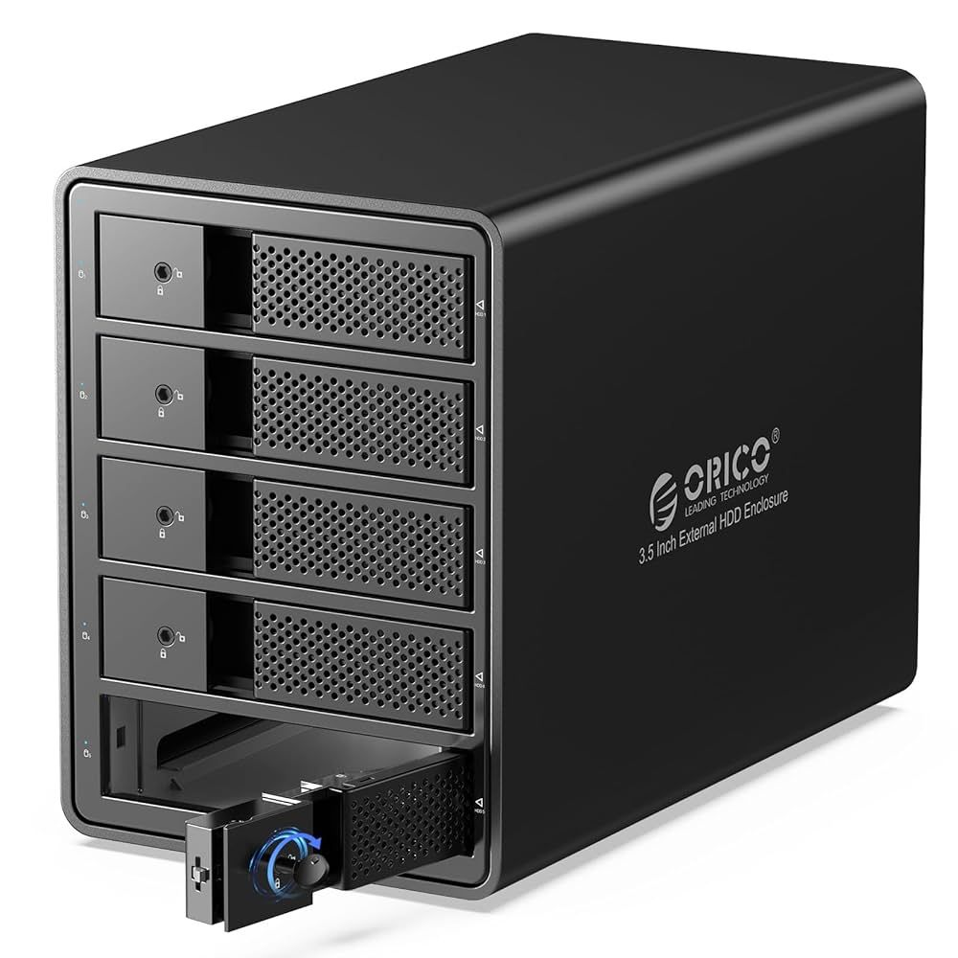
Network Attached Storage (NAS)

Slide 33
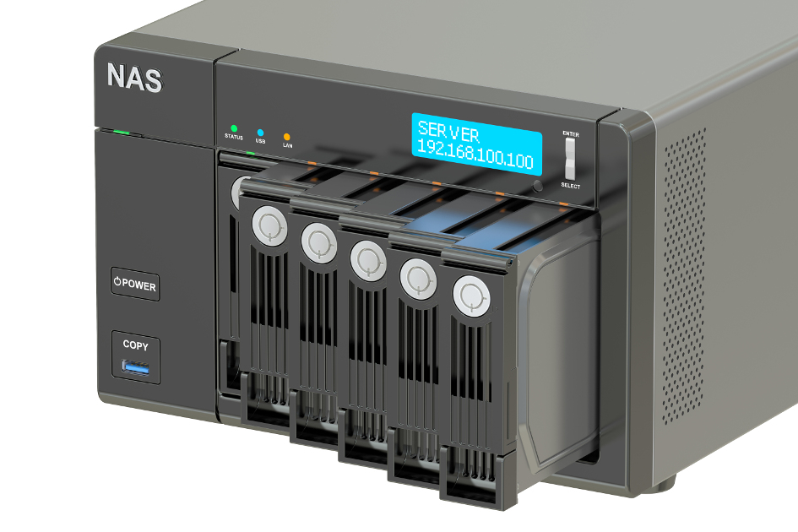
A storage device connected to a network
Allows multiple users/devices to access files from anywhere on the network
Acts like a personal file server

Slide 34
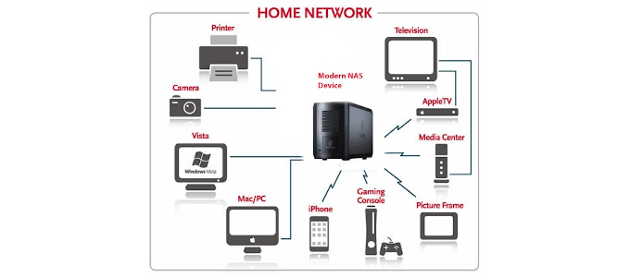
NAS connects to a router/switch via Ethernet (or Wi-Fi in some cases)
Users on the same network can access NAS storage like a shared drive
Can be set up for file sharing, backups, and media streaming
Managed through a simple web interface

Slide 35




Dedicated NAS Operating Systems

Slide 36
Why do we need a dedicated NAS operating system?
Easy Setup and management – web interface instead of complex commands
Optimized for Storage – built-in RAID, snapshots, file sharing protocols
User Access Control – create accounts, permissions, groups easily
Data Protection – supports ZFS/Btrfs, checksums, redundancy
Extra Services – media server, cloud sync, backup, virtualization
Remote Access – secure login from anywhere
Stability & Reliability – purpose-built, tested for storage workloads

Slide 37
RAID (Redundant Array of Independent Disks)
A method of combining multiple hard drives into one system. RAID levels :
RAID 0 – Speed, no safety (data split across drives).
RAID 1 – Safety, no speed (data mirrored).
RAID 5/6 – Balance of speed + redundancy.
RAID 10 – Fast and safe (but needs more drives).

Slide 38
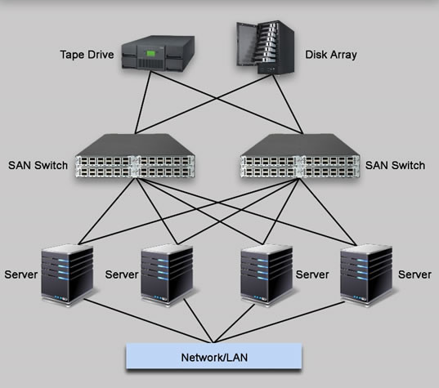
Storage Area Network (SAN)

Slide 39
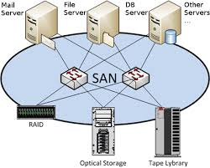
A dedicated high-speed network that connects servers to storage devices
Provides block-level storage (like a local hard drive to the server)
Used in data centers and enterprises, not usually at home

Slide 40
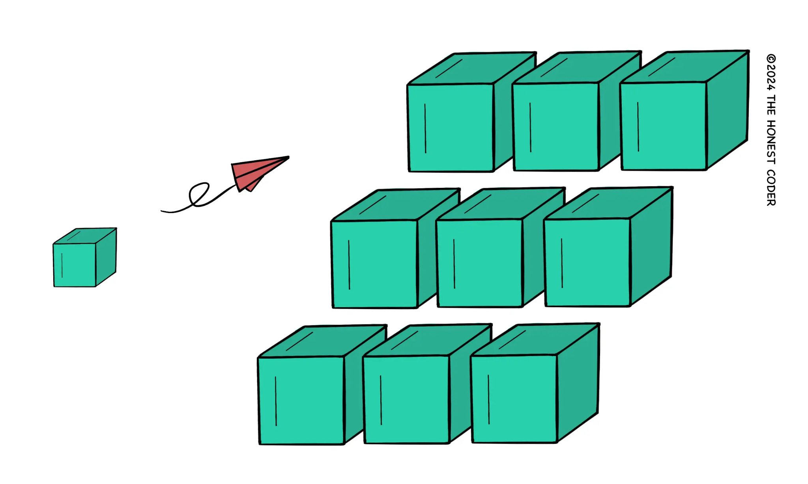
Extremely fast and reliable
Centralized storage pool for many servers
Scales to very large amounts of data
Great for mission-critical applications

Slide 41
